Slide 1
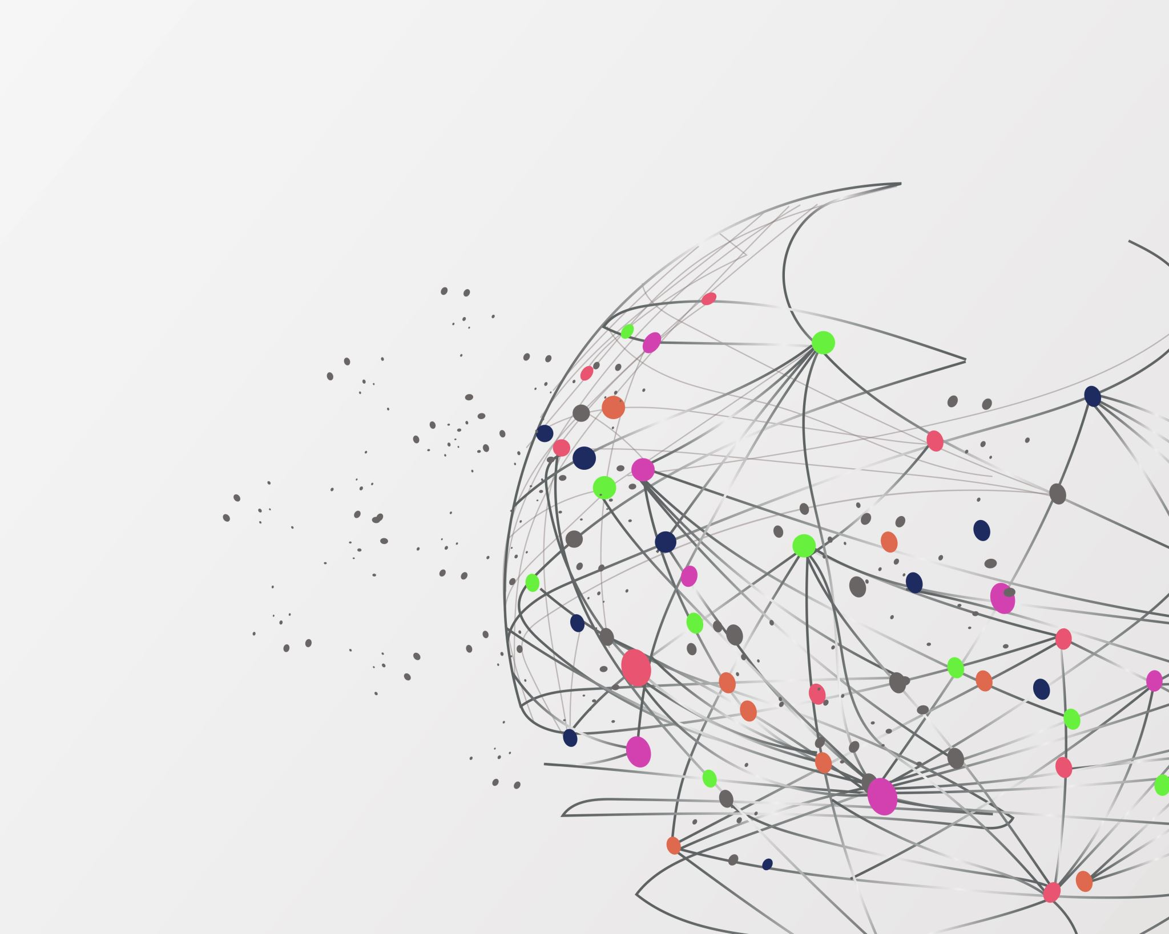

CVR COLLEGE OF ENGINEERING DEPARTMENT OF INFORMATION TECHNOLOGY MAJOR PROJECT SEMINAR-1
Topic :- Multi Disease Prediction By Using Machine Learning
Project Guide:
Mrs. Swathi Agarwal(Assistant Professor)
Team Members:
T. Arya (19B81A12C2)
K. Manasvini (19B81A12D4)
Ch. Mukesh(19B81A12E2)

Slide 2
ABSTRACT
Many models for health care analysis are concentrating on one disease per analysis. Like one analysis is for diabetes analysis, one for cancer analysis, one for skin diseases and so on. There is no common system where one analysis can perform more than one disease prediction. In this model we propose a system which is used to predict multiple diseases by using Flask API. In this model we perform Diabetes analysis, Diabetes Retinopathy analysis, Heart disease and breast cancer analysis. We try to implement multiple disease analysis used machine learning algorithms, TensorFlow and Flask API. Python pickling is used to save the model behavior and python unpickling is used to load the pickle file whenever required. The importance of this analysis is that while analyzing the diseases all the parameters which causes the disease is included so it possible to detect the maximum effects which the disease will cause. For example, for diabetes few parameters like age, sex, BMI , insulin, glucose, blood pressure, diabetes pedigree function, pregnancies, considered in addition to age, sex, BMI, insulin, glucose, blood pressure, diabetes pedigree function, pregnancies included serum creatinine, potassium, Glasgow Coma Scale, heart rate/pulse Rate, respiration rate, body temperature, low density lipoprotein (LDL), high density lipoprotein (HDL), TG (Triglycerides). Model’s behavior will be saved as python pickle file. Flask API will invoke the corresponding model and returns the status of the patient. The importance of this analysis to analyze the maximum diseases, so that to monitor the patient’s condition and warn the patients in advance to decrease mortality ratio.

Slide 3
INTRODUCTION
Now-a-days health industry plays major role in curing the diseases of the patients so this is also some kind of help for the health industry to tell the user and it is useful for the user in case he/she doesn’t want to go to the hospital or any other clinics, so just by entering the symptoms and all other useful information the user can get to know the disease he/she is suffering from .
Doctors are adopting many scientific technologies and methodology for both identification and diagnosing not only common disease, but also many fatal diseases.
The successful treatment is always attributed by right and accurate diagnosis.
Doctors may sometimes fail to take accurate decisions while diagnosing the disease of a patient, therefore Multiple Disease Prediction systems which use machine learning algorithms assist in such cases to get accurate results.
This is developed to overcome general disease in earlier stages, as we all know in competitive environment of economic development the mankind has involved so much that he/she is not concerned about health.

Slide 4
LITERATURE REVIEW
Classification and Diagnosis of Diabetes: Standards of Medical Care in Diabetes—2018 American Diabetes Association Diabetes Care 2018; 41(Supplement 1): S13–S27. https://doi.org/10.2337/dc18- S002.
In this paper, we have proposed a diabetes prediction model for better classification of diabetes which includes few external factors responsible for diabetes along with regular factors like Glucose, BMI, Age, Insulin, etc.
Chaitrali S. Dangare, Sulabha S. Apte, "Improved Study of Heart Disease Prediction System using Data Mining Classification Techniques", International Journal of Computer Applications (0975 888)Volume 47No.10, June 2012.
This paper has analysed prediction systems for Heart disease using more number of input attributes. The system uses medical terms such as sex, blood pressure, cholesterol like 13 attributes to predict the likelihood of patient getting a Heart disease
M.Mehdy, E.E.Shair and P.Y.Ng, “Decision Tree algorithm for Earlier Detection of Breast Cancer", Hindawi, Computational and Mathematical Methods in Medicine, Volume 2017, Article ID 2610628
The authors used a 10-fold cross-validation technique from the UCI machine learning repository named Wisconsin breast cancer diagnosis dataset, the techniques achieved the accuracy of 96% for Decision Tree algorithm

Slide 5
LITERATURE REVIEW
DhafarHamed, Jwan K. Alwan, Mohamed Ibrahim, Mohammad B. Naeem "The Utilisation of Machine Learning Approaches for Medical Data Classification" in Annual Conference on New Trends in Information & Communications Technology Applications - march2017 A. J. Jenkins, M. V. Joglekar, A. A. Hardikar, A. C. Keech, D. N. O'Neal, and A. S. Januszewski, “Biomarkers in diabetic retinopathy,” The Review of Diabetic Studies, vol. 12, no. 1-2, pp. 159–195, 2015.
In Machine Learning there are various types of algorithms such as Regression, Linear Regression, Logistic Regression, Naive Bayes Classifier, Bayes theorem, KNN (K-Nearest Neighbour Classifier), Decision Tress, Entropy, ID3, SVM (Support Vector Machines), K-means Algorithm, Random Forest and etc.,
Machine learning explores the study and construction of algorithms that can learn from and make predictions on data Machine learning is closely related to computational statistics, which also focuses on prediction-making through the use of computers. It has strong ties to mathematical optimization, which delivers methods, theory and application domains to the field

Slide 6
PROBLEM STATEMENT
Now-a-days mortality got increased due to exactly not identifying exact disease. Even the patient got cured from one disease may be suffering from another disease. This is a serious situation which must be considered, like this many instances have been observed in many people’s life stories. Hence looking at this problem we have decided to design this project which helps patients to predict the accurate disease of the patient using all their general information’s and the symptoms. If this prediction is done at the early stages of the disease with the help of this project and the disease can be cured. In general this prediction can also be very useful in health industry.

Slide 7
MODULES AND ITS DESCRIPTION
Modules:
1)Diabetes Prediction Result: User enter the values of the parameters of the diabetes disease and after prediction user get the result whether the user is suffering from the diabetes or not.
2)Heart Disease Prediction Result: User enter the values of the parameters of the heart disease and after prediction user get the result whether the user is suffering from the heart disease or not.
3)Breast Cancer Prediction Result: User enter the values of the parameters of the breast cancer disease and after prediction user get the result whether the user is suffering from the breast cancer or not.
4)Results: The user will know whether he/she is suffering from the disease or not

Slide 8
FUTURE ENCHANCEMENTS
We can extend our research by providing the facility of more interactive user interface which will be helpful.
We can extend our model by doing it as Mobile Application which can be easier to use compared to web application.
We can provide the facility for Backup creation also and we can also add more details and latest and a greater number of diseases too.
We can develop this model by including the details for the consultation of doctors if the patient condition is critical .

Slide 9
MINIMUM CONFIGURATION OF HARDWARE AND SOFTWARE REQUIREMENTs
HARDWARE REQUIREMENTS:
System :Pentium4, Intel Core i3,i5,i7 and 2GHz min
RAM : 512Mb or above
HardDisk : 10 GB or above
SOFTWARE REQUIREMENTS:
Python 3.7
scikit-learn
Python Flask
Windows 8 or Above Operating System
Python libraries:
NumPy
Pandas

Slide 10
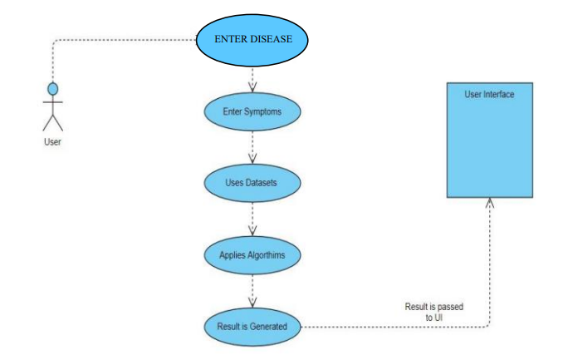
Use case diagram

Slide 11
SEQUENCE DIAGRAM

Slide 12
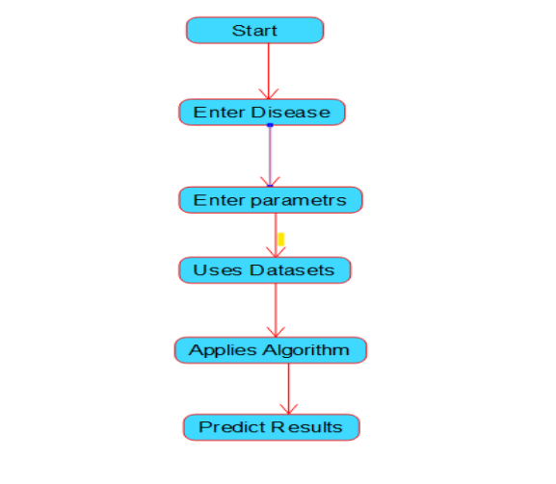
activity diagram

Slide 13
ANALYSIS AND DESIGN
Data pre-processing :
Using the module we will read data for processing
Dataset preparation :
Using this module we will load data into system
Splitting data into train & test:
Using this module data will be divided into train & test
Data Cleaning:
It is the process of preparing data for analysis by removing or modifying data that is incorrect, incomplete, irrelevant, duplicated, or improperly formatted.
Encoding:
It is a required pre-processing step when working with categorical data for machine learning algorithms.
Model Selection:
Building the model –
Random Forest
Naïve Bayes and Random Forest (Hybrid)
Logistic Regression

Slide 14
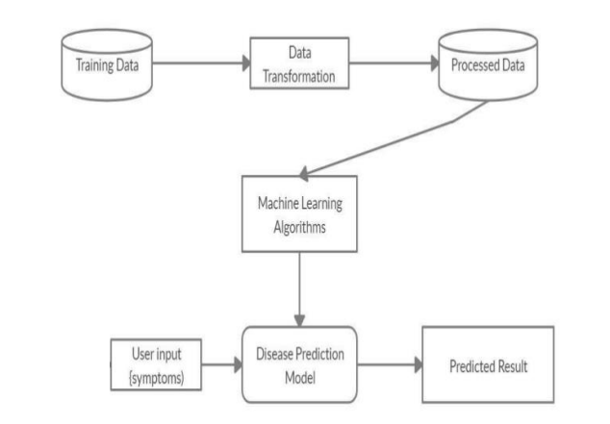
ARCHITECTURE

Slide 15
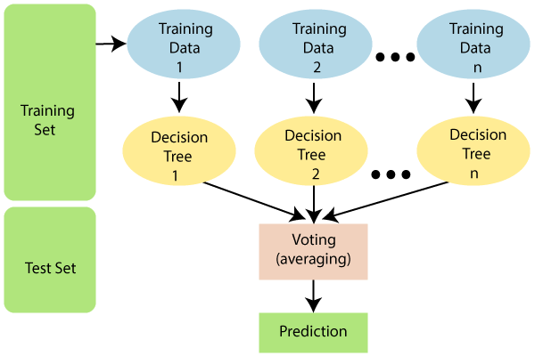
RANDOM FOREST ALGORITHM
Random forest is the supervised learning algorithm that can be used for both classification and regression problems in machine learning. It is an ensemble learning technique that provides the predictions by combining the multiple classifiers and improve the performance of the model.
It contains multiple decision trees for subsets of the given dataset, and find the average to improve the predictive accuracy of the model. A random-forest should contain 64-128 trees. The greater number of trees leads to higher accuracy of the algorithm.
To classify a new dataset or object, each tree gives the classification result and based on the majority votes, the algorithm predicts the final output.
Random forest is a fast algorithm, and can efficiently deal with the missing & incorrect data.

Slide 16

NAIVE BAYES ALGORITHM
Naive Bayes is the supervised learning algorithm which is based on Bayes theorem and can be used for both classification and regression problems in machine learning.
It classifies the class data based on the training set and the values in a classifying attribute and uses it in classifying new data.
It can solve both categorical and continuous values attributes.
Bayes theorem finds the probability of an event occurring given the probability of another event that has already occurred.
Bayes theorem is stated mathematically as the following equation:

Slide 17
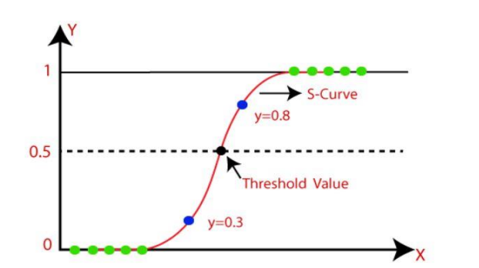
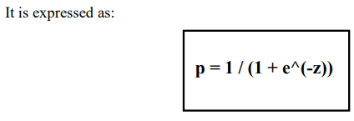
LOGIsTIc REGRESSION
Logistic regression is one of the most popular Machine Learning algorithms, which comes under the Supervised Learning technique.
It is used for predicting the categorical dependent variable using a given set of independent variables.
Logistic regression predicts the output of a categorical dependent variable.
Therefore, the outcome must be a categorical or discrete value. It can be either Yes or No, 0 or 1, true or False, etc. but instead of giving the exact value as 0 and 1, it gives the probabilistic values which lie between 0 and 1.
Logistic Regression Graph

Slide 18
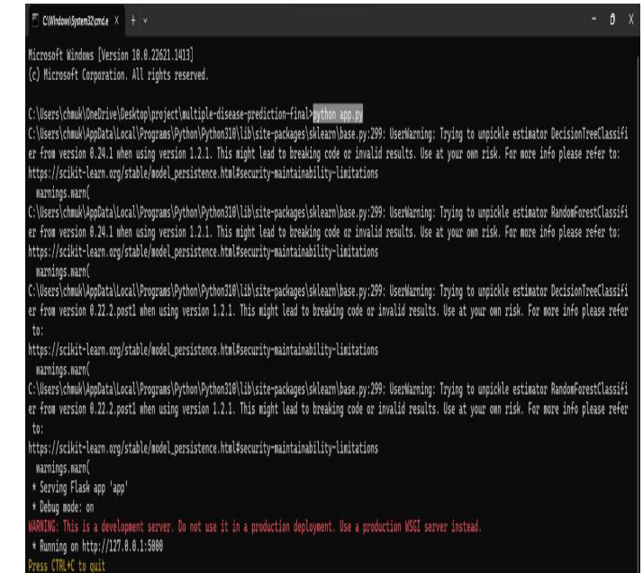
SCREENSHOTS
Deployment server established

Slide 19
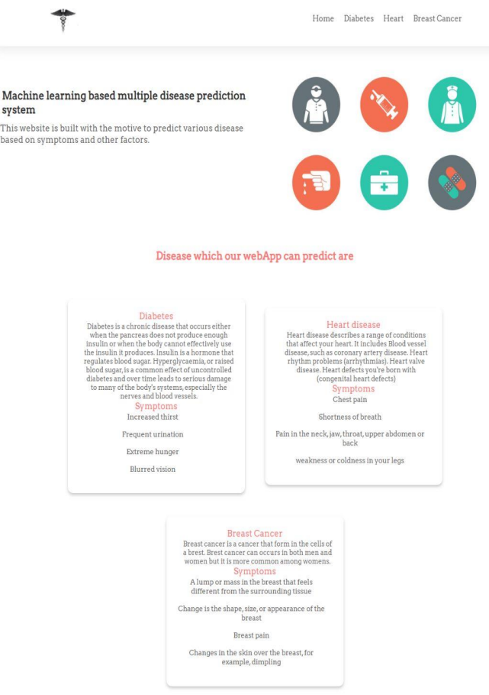
SCREENSHOTS
Home page

Slide 20
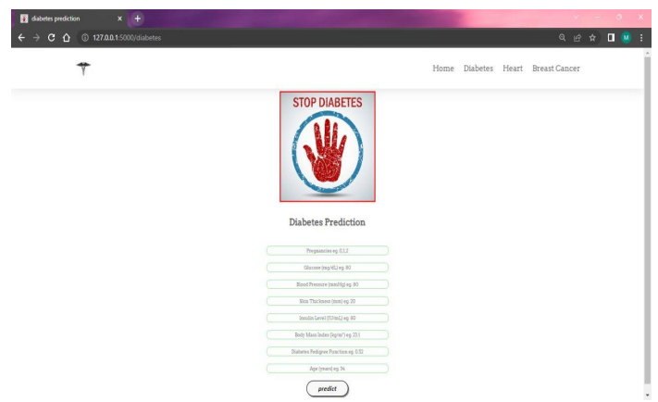
SCREENSHOTS
Diabetes disease prediction page

Slide 21
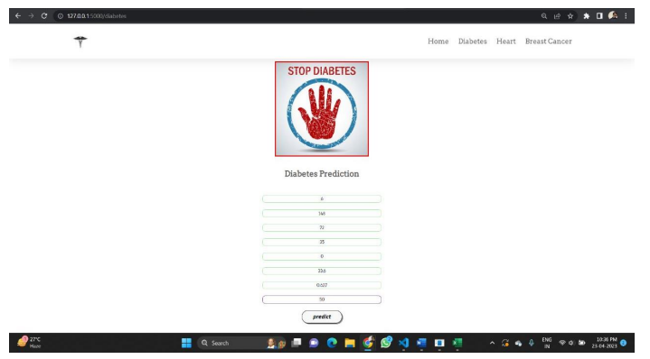
TEST CASES
Diabetes disease prediction values

Slide 22
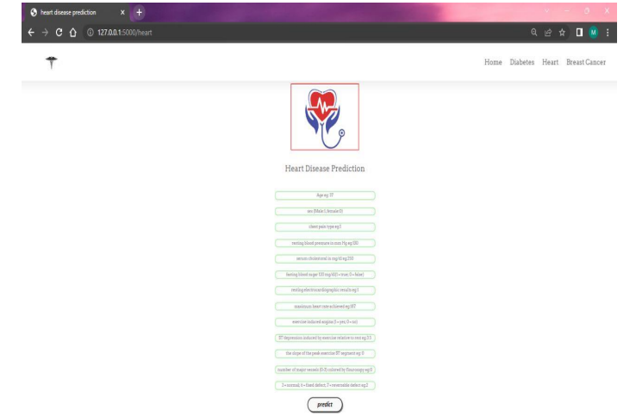
SCREENSHOTS
Heart disease prediction page

Slide 23
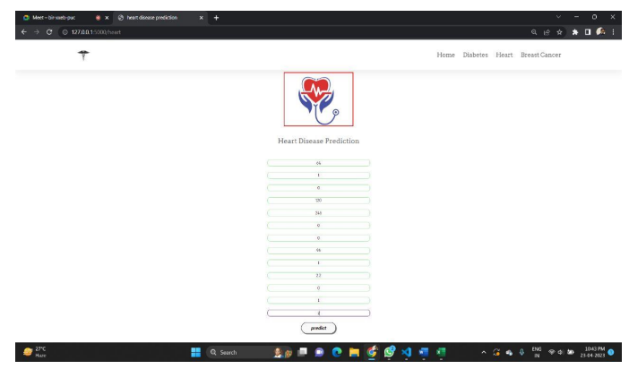
TEST CASES
Heart Disease Prediction values

Slide 24
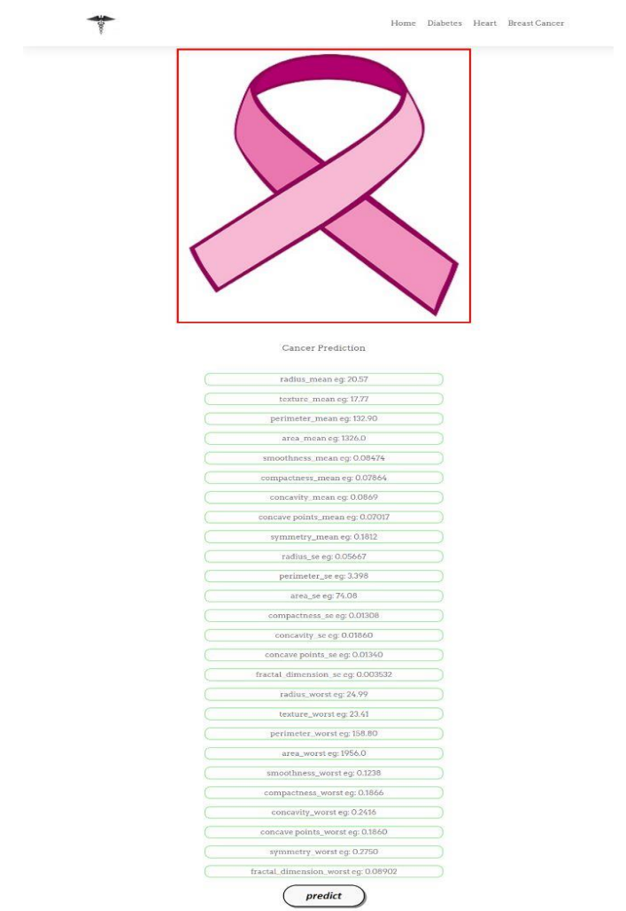
SCREENSHOTS
Breast Cancer Disease Prediction page

Slide 25
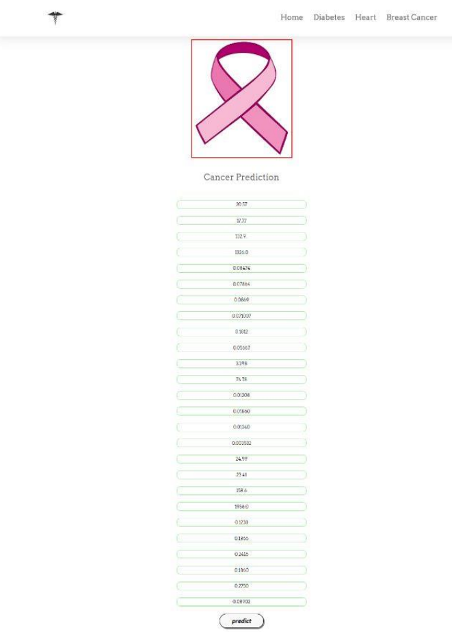
TEST CASES
Breast Cancer Disease Prediction values

Slide 26
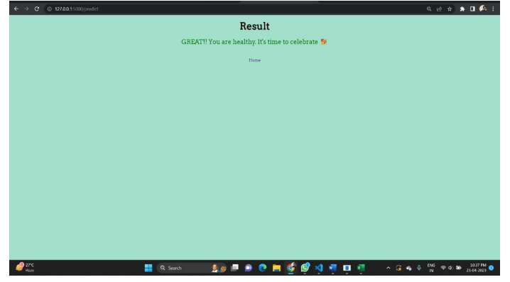
SCREENSHOTS
Result if user is not suffering from disease

Slide 27
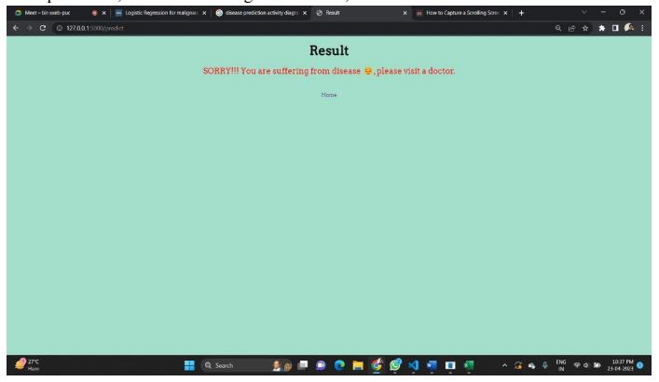
SCREENSHOTS
Result if user is suffering from disease

Slide 28
references
[1] Classification and Diagnosis of Diabetes: Standards of Medical Care in Diabetes— 2018 American Diabetes Association Diabetes Care 2018; 41(Supplement 1): S13 – S27. https://doi.org/10.2337/dc18 - S002. IEEE Transactions on health care.
[2] "Multi-disease prediction using machine learning: A survey" by Kaur and Singh (2020). This paper provides a survey of various machine learning algorithms for multidisease prediction, including decision trees, support vector machines, and random forests.
[3] "Multi-disease prediction using genetic algorithms and artificial neural networks" by Chen et al. (2018). This paper proposes a hybrid method that combines genetic algorithms and artificial neural networks for multi-disease prediction.
[4] "Multi-disease prediction using a hybrid machine learning approach" by Mingming Gong, et al. (2020): This paper proposed a hybrid machine learning approach for multidisease prediction. The Flask API was used to implement the system and provide a web interface for users to input their symptoms and receive predictions for multiple diseases.
[5] Chaitrali S. Dangare, Sulabha S. Apte, "Improved Study of Heart Disease Prediction System using Data Mining Classification Techniques", International Journal of Computer Applications (0975 888)Volume 47No.10, June 2012.
[6] M.Mehdy, E.E.Shair and P.Y.Ng, “Decision Tree algorithm for Earlier Detection of Breast Cancer", Hindawi, Computational and Mathematical Methods in Medicine, Volume 2017, Article ID 2610628.

Slide 29
references
[7] Cosentino F, Grant PJ, Aboyans V, Bailey CJ, Ceriello A, Delgado V, et al. ESC Scientific Document Group. 2019 ESC Guidelines on diabetes, pre-diabetes, and cardiovascular diseases developed in collaboration with the EASD. Eur Heart J 2020 41:255323. doi: 10.1093/eurheartj/ehz486.
[8] "A web-based system for multi-disease prediction using Flask API" by S. S. Patil and S. P. Mahajan (2020): This paper presents a web-based system for multi-disease prediction using Flask API. The system uses machine learning algorithms to predict the presence of multiple diseases based on a patient's symptoms. The system was evaluated on a dataset of 1,000 patients and achieved an accuracy of 85%.
[9] "Building a Web-based Framework for Predicting Multiple Diseases" by S. M. M. Hossain et al. (2021): This study proposed a web-based framework for predicting multiple diseases using machine learning techniques. The authors used Flask to develop a web API that allowed users to input patient data and receive predictions for multiple diseases.
[10] Prediction of Multiple Chronic Diseases Using Machine Learning Techniques" by N. K. Shrivastava and M. K. Soni (2021): This study proposed a machine learningbased approach for predicting multiple chronic diseases using electronic health records. The authors used Flask to develop a web API that allowed users to input patient data and receive predictions for multiple diseases.
[11] DhafarHamed, Jwan K. Alwan, Mohamed Ibrahim, Mohammad B. Naeem "The Utilisation of Machine Learning Approaches for Medical Data Classification" in Annual Conference on New Trends in Information & Communications Technology Applications - march2017 A. J. Jenkins, M. V. Joglekar, A. A. Hardikar, A. C. Keech, D. N. O'Neal, and A. S. Januszewski, “Biomarkers in diabetic retinopathy,” The Review of Diabetic Studies, vol. 12, no. 1-2, pp. 159–195, 2015.

Slide 30
CONCLUSION
Multi Disease Prediction project is undertaken using machine learning and evaluates the diseases. This project will predict the disease of Diabetes, Heart and breast Cancer by using different Machine Learning Algorithms i.e, Random Forest, Naïve Bayes and Logistic regression algorithm, as these algorithms give higher accuracy for the respective disease prediction. This web application is built using Flask API which is used to predict multiple diseases at a time.
Based on the user input, disease will be predicted. The choice will be given to user. If the user wants to predict particular disease, then based on user entered inputs corresponding disease model will be invoked and predicted. The advantage of multi disease prediction model in advance can predict the probability of occurance of a disease and also can reduce mortality ratio.
Now-a-days health industry plays major role in curing the diseases of the patients so this is also some kind of help for the health industry to tell the user and also it is useful for the user in case he/she don’t want to go to the hospital, so just by entering the parameters of the disease, the user can get to know whether he/she is suffering from particular disease or not.
If health industry adopts this application, then the work of the doctors can be reduced and they can easily predict the disease of the patient. Multiple Disease Prediction is to provide prediction for the various and generally occurring diseases that when unchecked and sometimes ignored can turns into fatal disease and cause lot of problem to the patient and as well as their family members.

